Slide 1
X Education - Lead Scoring Case Study
Identification of Hot Leads to focus more on them and thus enhancing the conversion ratio for X Education
Team Members:
Piyush Gupta
Prashant Singh
Arun Tiwari

Slide 2
Context
X Education , An education company named sells online courses to industry professionals
Many interested professionals land on their website
The company markets its courses on several websites like Google. Once these people land on the website, they might browse the courses or fill up a form for the course or watch some videos
When these people fill up a form providing their email address or phone number, they are classified to be a lead
Once these leads are acquired, employees from the sales team start making calls, writing emails, etc. Through this process, some of the leads get converted while most do not
The typical lead conversion rate at X education is around 30%
X Education Company

Slide 3
Problem Statement
X Education gets a lot of leads, but its lead conversion rate is very poor
To make this process more efficient, the company wishes to identify the most potential leads, also known as ‘Hot Leads’
If they successfully identify this set of leads, the lead conversion rate should go up as the sales team will now be focusing more on communicating with the potential leads rather than making calls to everyone
We will help them to select the most promising leads, i.e., the leads that are most likely to convert into paying customers.
We are required to build a model wherein we need to assign a lead score to each of the leads such that the customers with higher lead score have a higher conversion chance
The CEO has given a ballpark of the target lead conversion rate to be 80%.
X Education Company’s Problem

Slide 4
Lead – Conversion Process
Lead Generation:
1. Ads on websites like Google
2. Referrals
Visit to X Education website by these potential customers (professionals)
Visitors either provide Email id & Contact Details
Or
View videos etc
Tele calling and Emailing activity to all the leads
~30% leads get converted
Lead to Conversion process
Proposed Solution:
A model to filter leads so that leads to conversion ratio is 80%+

Slide 5
Proposed Solution
Selection of Hot Leads
Communicating with Hot Leads
Conversion of Hot Leads
Leads Clustering
We cluster the leads into certain categories based on their tendency or probability to convert, thus, getting a smaller section of hot leads to focus more on.
Focus Communication
Since we would have a smaller set of leads to have communication with, we might make more impact with effective communication.
Increase conversion
Since we focussed on hot leads, which were more probable to convert, we would have a better conversion rate, and hence we can achieve the 80% target.

Slide 6
Solution
For our Problem Solution, the crucial part is to accurately identify hot leads.
The more accurate we obtain the hot lead, the more chance we get of higher conversion ratio.
Since we have a target of 80% conversion rate, we would want to obtain a high accuracy in obtaining hot leads.
Selection of Hot Leads

Slide 7
Implementation

Slide 8
Loading & Observing the past data provided by the Company
Univariate, Bivariate, and Heatmap for numerical and categorical columns
Performing pre-requisites for RFE and Logistic Regression
Data Gathering
Data Cleaning
Performing EDA
Data Preparation
Model Building
Duplicate removal, null value treatment, unnecessary column elimination, etc.
Outlier Treatment, Feature-Standardization

Slide 9
Selection of top 25 features using RFE
Reduction of columns and Model re-building
Verifying our Final Model Accuracy etc. with model built with PCA
Feature Selection
Model Building
Model Improvement
Final Model
Verifying with PCA
Model building using RFE for selected columns
Final Model Analysis and performance on Test Data

Slide 10
Plots (Visualization)

Slide 11
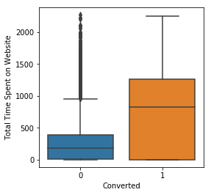
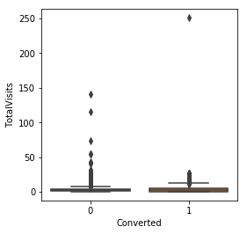
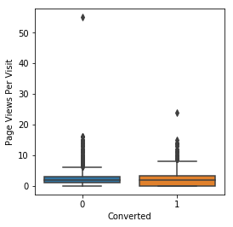
EDA plots depicting variation in numerical columns for those who Converted and those who didn't.

Slide 12
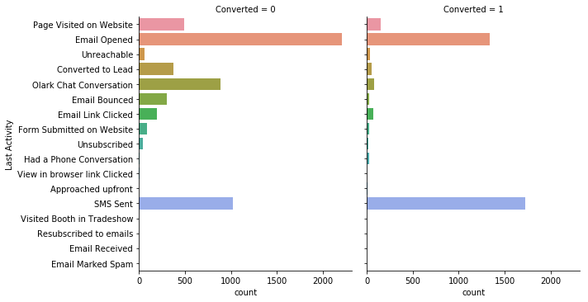
EDA plots depicting variation in categorical column (Last Activity) for those who Converted and those who didn't.

Slide 13
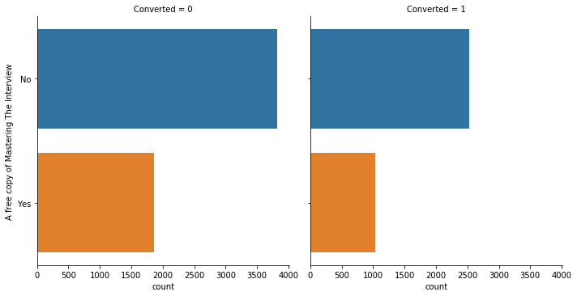
EDA plots depicting variation in categorical column (A free copy of Mastering The Interview) for those who Converted and those who didn't.

Slide 14
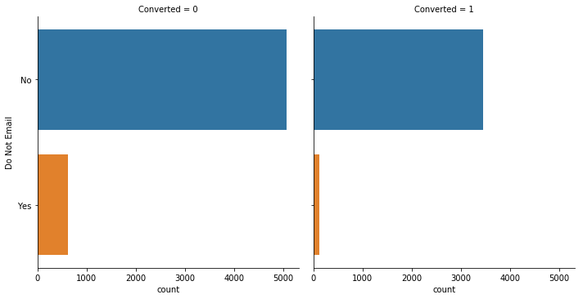
EDA plots depicting variation in categorical column (Do Not Email) for those who Converted and those who didn't.

Slide 15
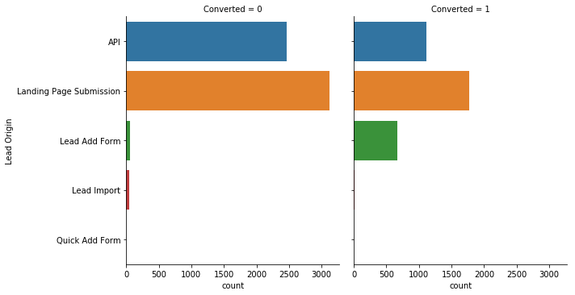
EDA plots depicting variation in categorical column (Lead Origin) for those who Converted and those who didn't.

Slide 16
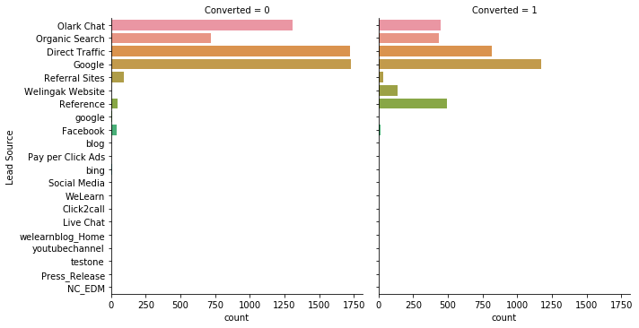
EDA plots depicting variation in categorical column (Lead Source) for those who Converted and those who didn't.

Slide 17
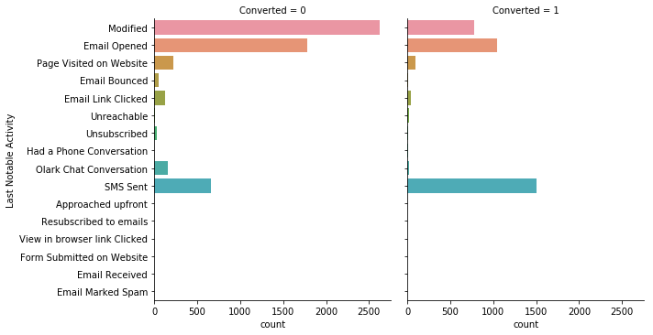
EDA plots depicting variation in categorical column (Last Notable Activity) for those who Converted and those who didn't.

Slide 18
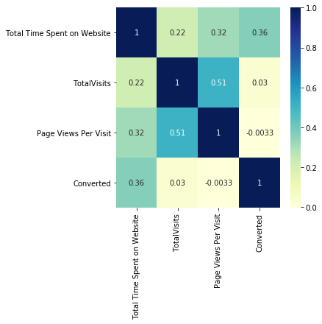
EDA plots depicting correlation (Heat Map) of all selected numerical columns.

Slide 19
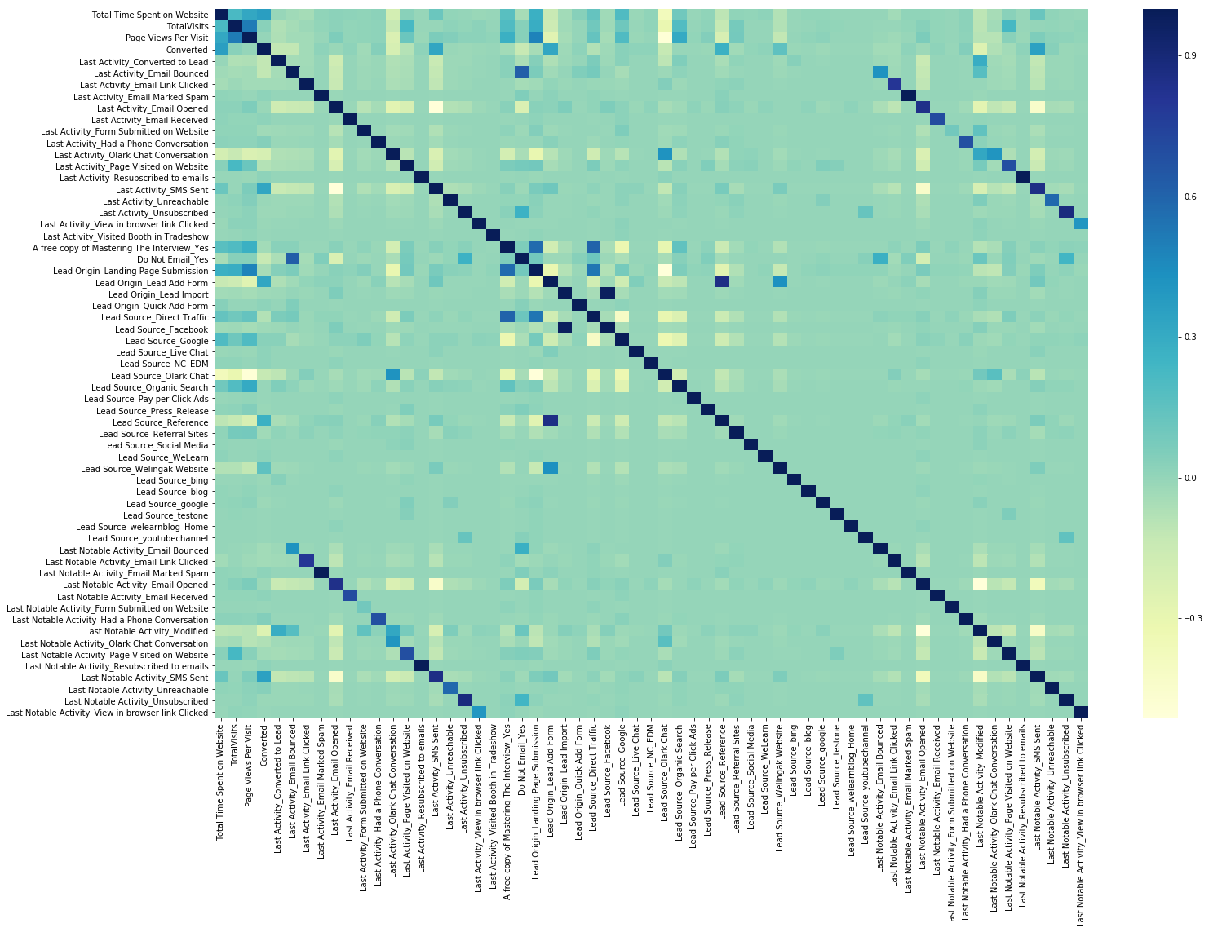
EDA plots depicting correlation (Heat Map) of all selected columns (numerical columns and dummy columns).

Slide 20
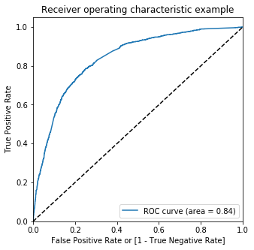
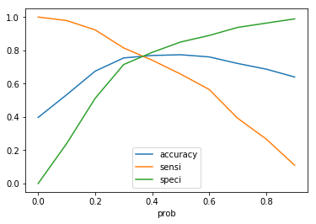
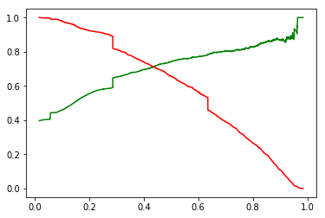
Linear Regression Final Model Parameters
Area under ROC = 0.84
Intermediate cut-off = 0.35
Final cut-off = 0.42

Slide 21
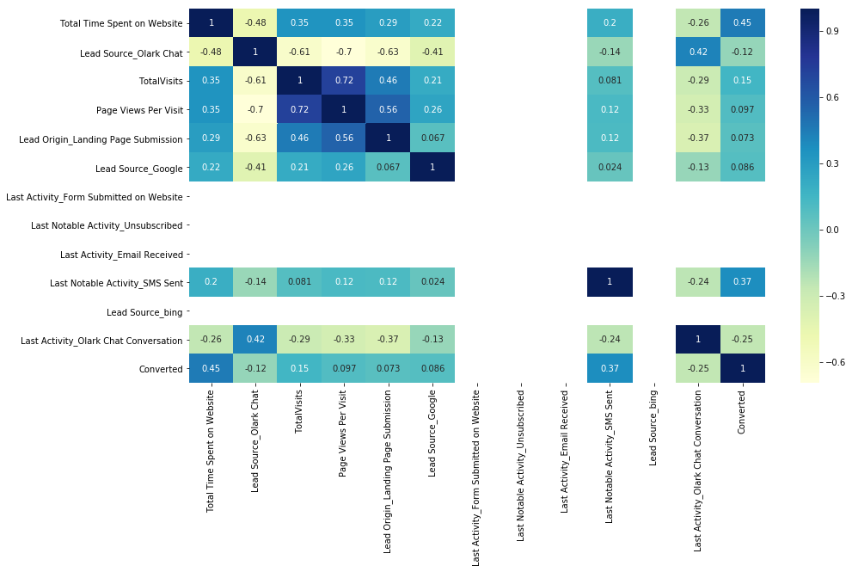
EDA plots depicting correlation (Heat Map) of all selected columns (numerical columns and dummy columns) in our final Model.

Slide 22
Inference / Conclusion

Slide 23
Model Analysis
Overall accuracy on Test set: 0.786
Sensitivity of our logistic regression model: 0.733
Specificity of our logistic regression model: 0.823
Performance of our Final Model

Slide 24
Inferences from Model
Top 3 variables in model, that contribute towards lead conversion are:
Total Time Spent on Website
Last Notable Activity_SMS Sent
TotalVisits
Business Insights Derived from our Model

Slide 25
Inferences from Model
Top 3 variables in my model, that should be focused are:
Last Activity_SMS Sent (positively impacting)
Last Activity_Olark Chat Conversation (negatively impacting)
Lead Source_Olark Chat (negatively impacting)
Business Insights Derived from our Model

Slide 26
Conclusion 1 (LR Model)
Our Logistic Regression Model demonstrates satisfactory performance and accuracy, particularly when compared to the model derived using PCA. It achieves an accuracy of 78.6% on the Test Set, with a sensitivity of 73.3% and specificity of 82.3%.
By adjusting the cut-off value, we can modify these parameters and effectively predict Hot leads based on different scenarios, such as the availability of additional resources or vice versa. This flexibility allows us to adapt the model to specific business needs and optimize lead prediction outcomes accordingly.

Slide 27
Conclusion 2 (Recommendation)
X Education Company should prioritize the following key areas to enhance the overall conversion rate:
Enhancing user engagement on their website: Increased user engagement has a direct positive impact on conversion rates. Therefore, efforts should be made to optimize user experience, encourage active participation, and provide valuable content to keep visitors engaged.
Increasing the frequency of sending SMS notifications: Leveraging SMS notifications has proven to be an effective strategy in driving higher conversion rates. By implementing targeted and personalized SMS campaigns, X Education Company can effectively engage with potential leads and guide them towards conversion.
Enhancing Total visits through advertising initiatives: Boosting the number of website visits, particularly through well-executed advertising campaigns, contributes to higher conversion rates. X Education Company should explore various advertising channels and strategies to attract a larger audience and generate increased interest in their offerings.
Improving the Olark Chat service: The current state of the Olark Chat service is negatively impacting the conversion rate. It is crucial for X Education Company to address any shortcomings or issues with the chat service promptly. Enhancements to its functionality, responsiveness, and user experience can help foster better communication with potential leads and ultimately improve conversion rates.

